Slide 1

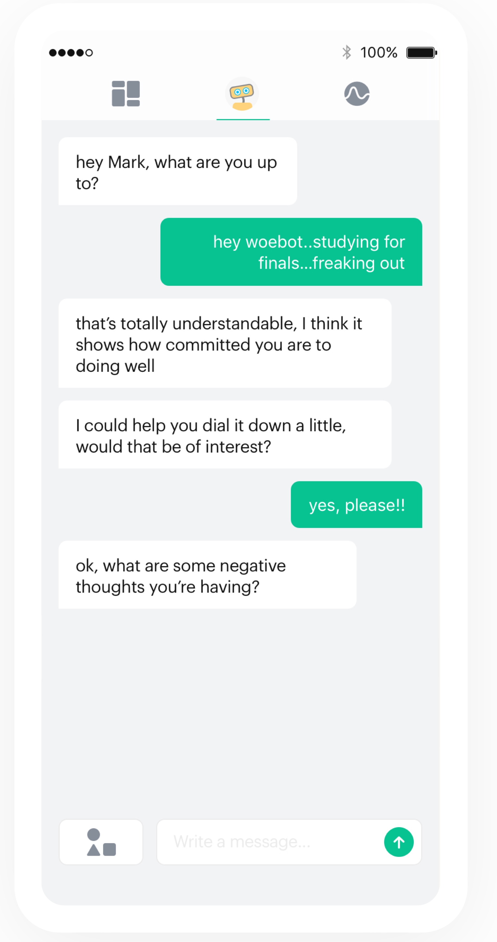
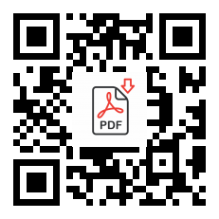
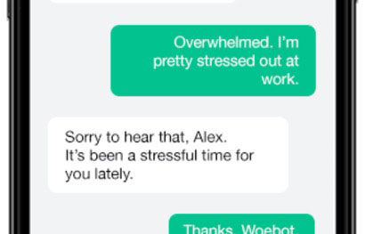
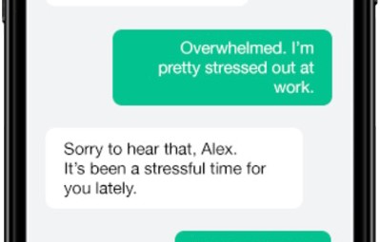
Efficacy of an Automated Conversational Agent on Postpartum Mental Health: A Randomized, Controlled Trial
Anita Gunaseelan, MS2¹, Maya Ramachandran, MS4², Sanaa Suharwardy, MD², Stephanie A. Leonard, MD², Athena Robinson³, Amy Judy, MD²
¹UC Davis School of Medicine, Sacramento, CA; ²Stanford University School of Medicine, Stanford, CA; ³Woebot Labs, Inc., San Francisco, CA
OBJECTIVE
RESULTS
BASELINE CHARACTERISTICS
There are many barriers to accessing postpartum mental health resources, which include limited availability and cost. Automated conversational agents (chatbots) can deliver cognitive-behavioral-therapy content through message-based conversations, reducing depression and anxiety symptoms in select populations. With many providers turning to telemedicine to provide care for patients, chatbots can work at a much larger scale and can support patients who cannot afford care or communicate well in English. This study evaluates the efficacy and acceptability of a chatbot as a postpartum mood management tool, as assessed by 5 validated scales.
152 women completed baseline and 6 week surveys. There was a significant decrease in mean PHQ-9 score in the chatbot group from baseline to 6 weeks (-1.32, p=0.025). At 6 weeks postpartum, mean EPDS and GAD scores were similar to baseline and did not differ between groups. 74% of women reported use of the chatbot at least once in the 2 weeks prior to 6 w survey, while 26% of patients reported no use over that time. Of the 68 chatbot users, 91% were satisfied with the application at 6 weeks postpartum and 71% found the application acceptable.
Characteristic | Control % (N=96) | Intervention % (N=96)
Age (years) 18-34 35+ | 56 44 | 59 41
Race or ethnicity White Asian/PI Latino Other | 34 41 20 5 | 46 39 8 7
Employed | 76 | 77
Married | 82 | 91
Pre-existing mental health condition | 10 | 16
Previously on therapy | 35 | 39
Currently on therapy | 18 | 30
Comfort with use of mobile app for mood management | 80 | 80
RESULTS
STUDY DESIGN
Participants who were English-speaking, ≥ 18 years, owned a smartphone, and delivered a liveborn neonate were recruited during their birth hospitalization and randomized to chatbot use or treatment as usual. Exclusion criteria were women with a fetal or neonatal demise during this hospitalization. EPDS (Edinburgh Postnatal Depression Scale), PHQ (Patient Health Questionnaire-9), and GAD (Generalized Anxiety Disorder-7) were administered during birth hospitalization and at 6 weeks postpartum, with lower scores reflecting decreased depression and anxiety. CSQ-8 (Client Satisfaction Questionnaire) and WAI-SR (Working Alliance Inventory – Short Revised) were used to assess satisfaction and acceptability in the chatbot group.
CONCLUSIONS
In this self-selected group of postpartum women, use of an automated conversational agent improved mean PHQ-9 score but not EPDS or GAD-7 scores in women who did not have baseline clinical levels of depression or anxiety by the aforementioned scales. The use of a chatbot demonstrated improved depression scores with sustained normative mood at 6 w postpartum. Participants showed high satisfaction with and acceptability of a chatbot in the 6-wk postpartum period. Future studies are encouraged to analyze the utility of such digital therapeutics, specifically among women with clinical levels of postpartum depression.
Mental Health Assessment Score
EPDS: Edinburgh Postnatal Depression Scale; PHQ-9: Patient Health Questionnaire-9, GAD-7: Generalized Anxiety Disorder-7.
* Statistically significant difference in mean PHQ-9 score at 6 wk compared to baseline in chatbot group (Mean difference -1.32, SD 3.40, p=0.025).
No statistically significant mean change of EPDS or GAD-7 scores at 6 wk compared to baseline (EPDS p=0.87, GAD-7 p=0.19).

